Slide 1
BODY FLUIDS
Dr. Wafa Mubarak

Slide 2

Body composition
In average young adult male body compositions are: (% of body weight)
Protein, & related substances 18%
Fat 15%
Mineral 7%
Water 60%
Carbohydrates < 1%

Slide 3
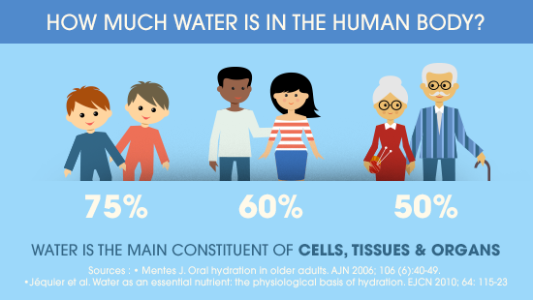

Slide 4
The % of TBW is affected by :-
1- Age :
It decrease by increasing age.
2- The percent of fats in the body:
Increased fats in the body is associated with less water.
This explain the higher % of TBW in :
Adult male compared to equivalent female.
Thin tall subject when compared to obese-short subject.

Slide 5
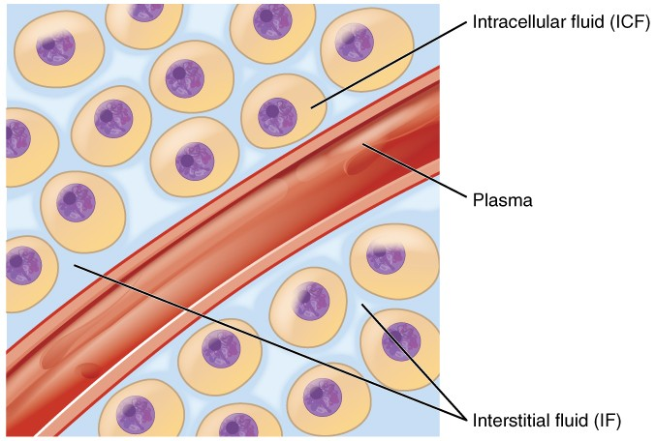
Water content in body is divided into 2 compartments:
(ECF)

Slide 6
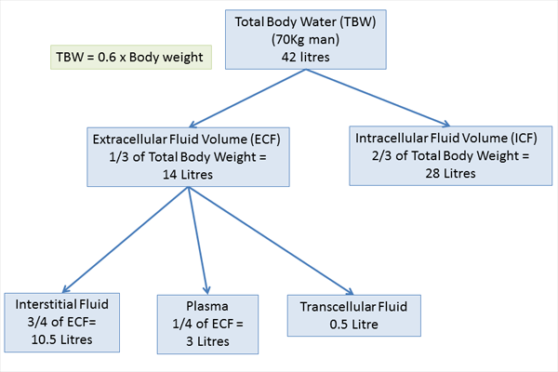
In
3.5 L
* Trance-cellular fluids

Slide 7
How to calculate total body water (TBW)?
Q. Calculate TBW for a 70 kg man.
TBW = 60% of body weight( 60/100)
TBW =
60% X 70 = 60/100 x 70 = 42 L of water

Slide 8
Electrolyte composition of Body Fluids
What is an electrolyte?
An electrolyte is a substance that when dissolved in water, gives a solution that can conduct electricity.

Slide 9
14 L
28 L

Slide 10
OSMOALRITY :
Is the number of osmoles of solute per liter of solution.
( REMEMBER: osmolality is the number of osmoles per kilograms of solvent)
If a solute dissociate into ions to form an ideal solution, each liberated ion is an osmotically active particle.
The osmotically active particles can exert osmotic pressure if they are in contact with another solution but separated from it by semipermeable membrane.

Slide 11
Osmolarity of the plasma =
280-300 mosm/l

Slide 12
Tonicity:
Used when describing the osmolarity of a solution relative to the osmolarity of the plasma.
So that there are 3 types of solution:
Isotonic : with osmolarity similar to plasma.
Hypotonic : with osmolarity lower than plasma.
Hypertonic: with osmolarity higher than plasma.

Slide 13
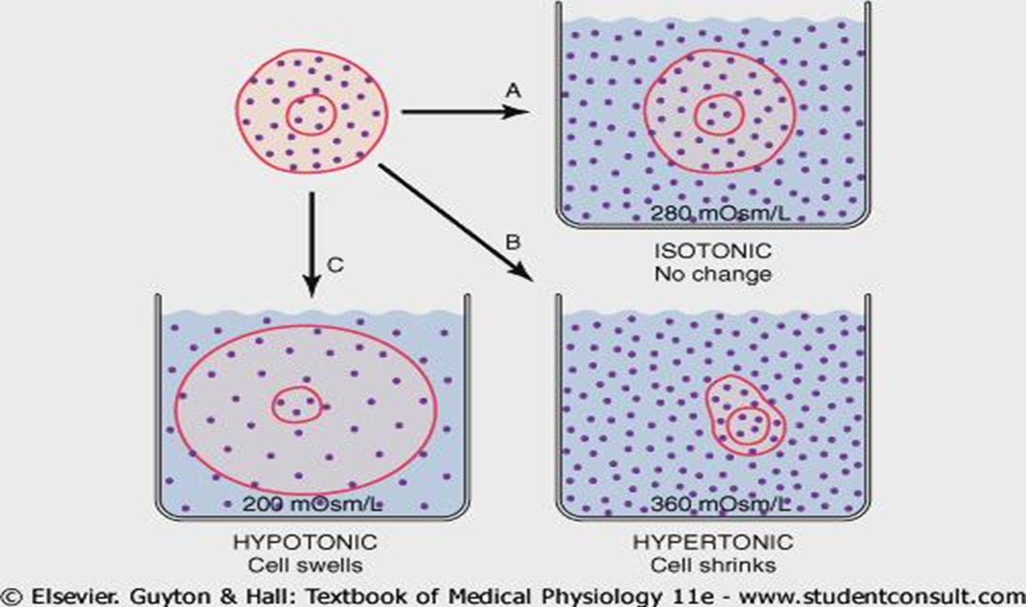
Effect of different types of solutions on cells

Slide 14
Factors affecting body fluid compartments
Diffusion
Osmosis
Gibbs Donnan equilibrium
Sodium potassium pump
Starling’s forces

Slide 15
1- Diffusion
The diffusion is the process by which the gas or a substance in solution expands because of the motion of its particles to distribute in all the available volume.
Water follows somatically active particles.

Slide 16
2- Osmosis
It is the movement of water molecules across a semi permeable membrane, from a region of low concentration of solute to a region of high concentration of solute.

Slide 17
3- Gibbs Donnan equilibrium
The presence of non-diffusible anions (protein and organic phosphate) within the cell affects distribution of diffusible ions (both anions and cations);
it allows entry of diffusible cations (e.g. Na+) into the cell and decrease entry of diffusible anions (e.g. Cl-).

Slide 18
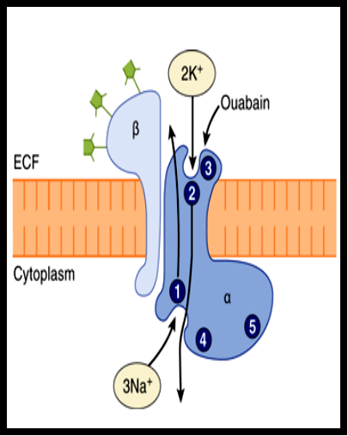
4- Na + _ K + pump
The energy extrude 3 Na+ from the cell and take 2 K + in to the cell for each molecules of ATP hydrolyzed .
Coupling ratio 3:2
Found in all parts of the body

Slide 19
Function of the Na + _ K + pump :
Participates in genesis of resting membrane potential (i.e. generate negative charges towards inner side of the cell membrane) → Electronic pump 3+ve charges out and 2+ve charges in.
Prevent swelling and rupture of the cell by removing excess sodium ions to outside.

Slide 20
Fluid Exchange Between Body Fluid Compartments
Movement of water between the ICF and the ISF (ECF) through the cell membrane is determined by :
Osmosis

Slide 21
Distribution of water between the ISF and Plasma is determined by:
1-Movement of water through the capillary walls, which is determined by Forces that leads to:
*filtration of water out of the capillary *reabsorb water into the capillaries
(Starling Forces)
Lymphatic drainage of the ISF and proteins back to the plasma (2-3 L/day)

Slide 22
Fluid exchange at the Capillaries

Slide 23
The ECF compartment is divided into intravascular compartment(plasma) and the interstitial fluid compartment (ISF)
Plasma and ISF communicate at the capillary walls
The Exchange between ISF and plasma at the capillaries is essential to the survival of cells and tissues.

Slide 24
Most of the Capillary walls have pores that make it highly permeable.
O2 and CO2 can diffuse across the membrane easily.
Water and all water soluble solutes can cross the capillary wall easily by diffusion through the pores except plasma proteins.

Slide 25
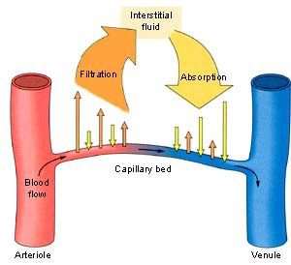

Slide 26
Forces that affect movement of water between plasma and ISF(starling forces):
1- Capillary hydrostatic pressure: (Pc)
Force exerted by blood as it pushes fluid out from plasma into the ISF
(push against the walls of the capillaries)
2- Interstitial fluid hydrostatic pressure (Pi):
Positive hydrostatic pressure in the ISF can oppose filtration from plasma into the ISF

Slide 27
3- Capillary oncotic pressure (Colloid osmotic pressure)
-It is the osmotic pressure exerted by proteins.
-Plasma oncotic pressure pulls water by osmosis from the ISF into plasma inside the capillaries
Remember that :
any solute that can not diffuse across a membrane can generate an osmotic pressure that pulls water in.

Slide 28
4- ISF Oncotic pressure
In normal conditions:
The protein concentration in ISF is much less than plasma
so the ISF oncotic pressure is much less than capillary oncotic pressure
The causes of low protein concentration in the ISF:
The capillary walls are impermeable to plasma proteins
Plasma proteins which leak into the ISF are removed from ISF by action of the lymphatics

Slide 29
Forces that affect movement of water between plasma and ISF:
Capillary hydrostatic pressure (Pc)
Interstitial fluid hydrostatic pressure (Pif)
Capillary Oncotic pressure (∏c)
ISF Oncotic pressure (∏if) (niglicted)
These Four forces are called
the Starling forces

Slide 30

Capillary Oncotic p = 25mmhg
CHP= 35 mmhg
CHP= 15
mmhg
*CHP= capillary hydrostatic pressure

Slide 31
The role of lymph flow in fluid exchange between plasma and ISF
10% of filtered fluids are not reabsorbed. This amount of fluid is carried back to blood by the lymphatic flow
The lymphatics also carries proteins and tissue debris from the interstitial space back to blood

Slide 32


